Slide 1
SIGN LANGUGAE RECOGNITION

Slide 2

Introduction
Sign Language Recognition utilizes machine learning to interpret sign
language gestures, enabling translation into text or speech. It enhances
inclusivity by bridging communication gaps between deaf and dumb
individuals, promoting accessibility and facilitating effective
communication.

Slide 3
agenda
Motivation
Data Resources
Data Processing
EDA
Data training
VIT model
Evaluation

Slide 4
Motivation
Developing accurate sign language recognition systems aims to empower individuals with hearing impairments, including both deaf and dumb individuals. By bridging communication gaps, these systems enhance accessibility, promote inclusivity across various fields like education, healthcare, and technology.

Slide 5
Data Resources
Accurate and diverse data is the backbone of machine learning models. It's essential to have reliable resources for training, validating, and testing our models.
In our Dataset: 60900 rows × 2 columns Images: 60900

Slide 6
Data Processing
Cleaning: Handle missing values, remove duplicates.
Transformation: Engineer features, normalize/standardize data, encode categorical variables.
Enrichment: Combine datasets, handle outliers.
Splitting: Divide data into training and testing sets.
Visualization: Visualize data distribution and patterns.

Slide 7
Exploratory Data Analysis (EDA)
Checking the shape of the dataset to understand its size and dimensions.
Examining data types to ensure they are appropriate for analysis.
Identifying and handling missing values to maintain data integrity.
Exploring statistical summaries to understand the distribution of numerical features.
Visualizing categorical data to analyze their distribution and imbalance.

Slide 8
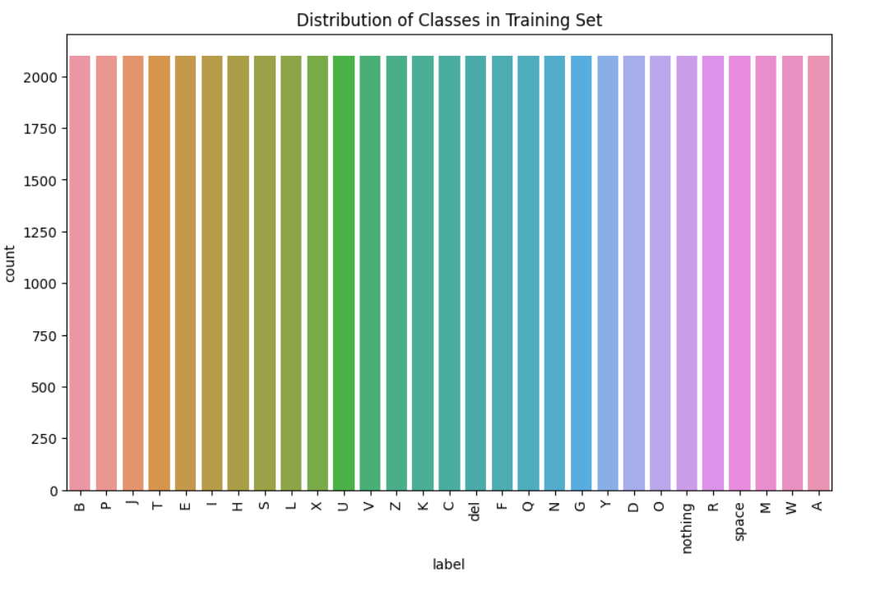

Slide 9
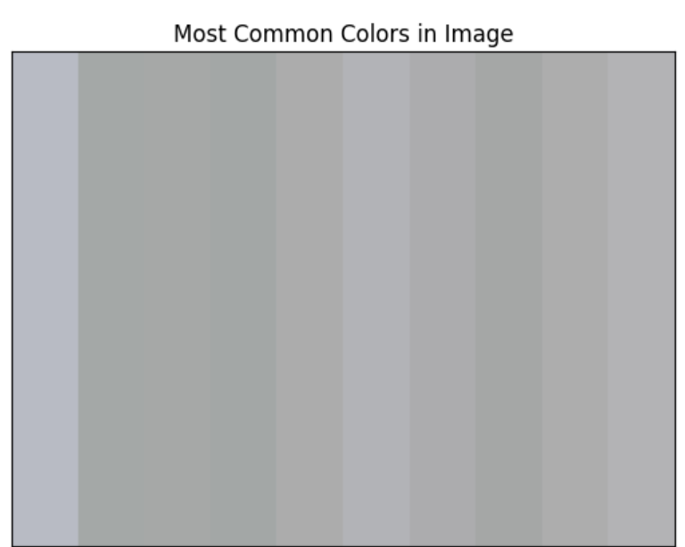
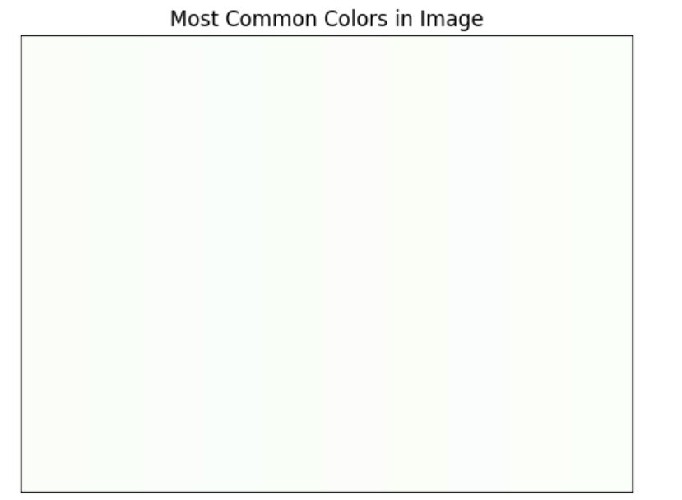
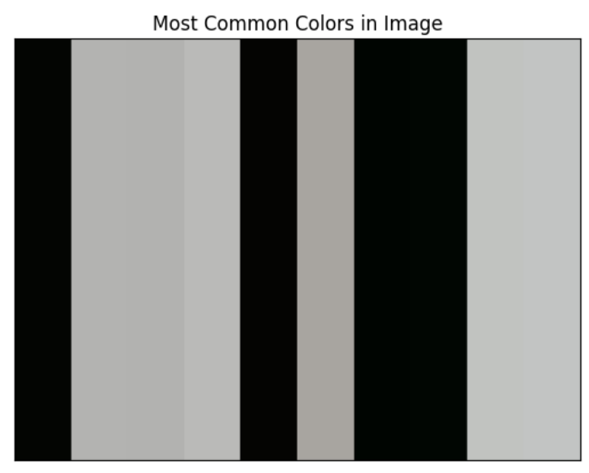
Displaying distribution and most common colors in the random images

Slide 10
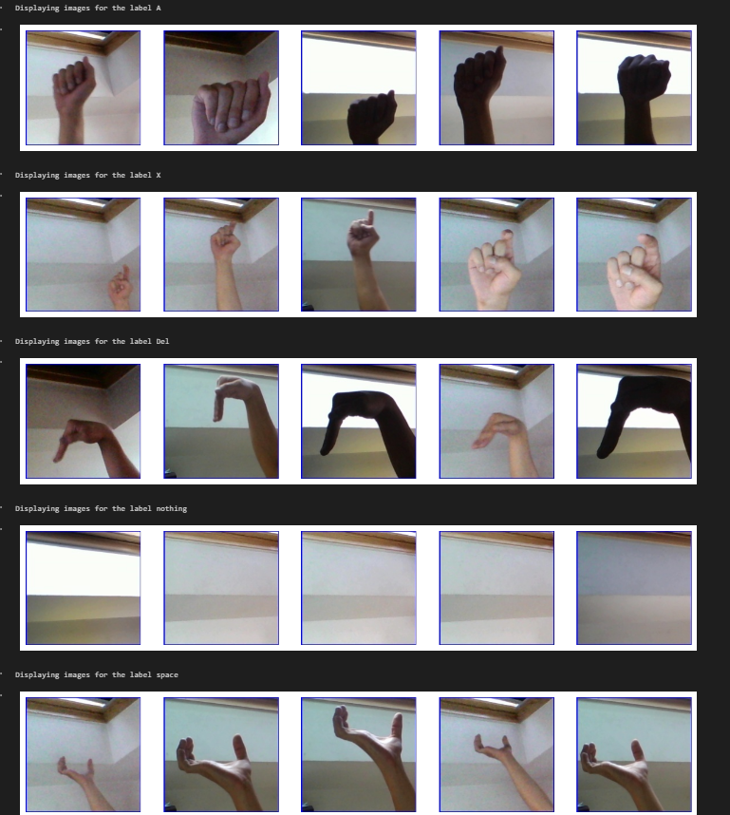
Data Visualization

Slide 11
Data Training
Setting up data loaders
Defining loss functions
Running the training loop
Adjusting model parameters
Learning and recognizing sign language gestures

Slide 12
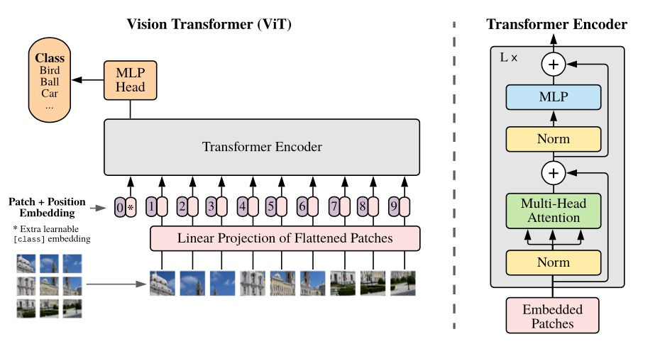
Vision Transformer (ViT) Model
VIT comprises transformer encoder layers with self-attention and feed-forward networks.
It processes images as sequences of patches, allowing it to capture both local and global features effectively.

Slide 13
Evaluation
Evaluation: Assessing the performance of the trained VIT model on a separate dataset using metrics like accuracy, precision, recall, and F1-score.

Slide 14
Thank you

